Slide 1
COMPANY PRESENTATION

Slide 2
ABOUT US
SIGMA GROUP, with its ofﬁces in Kazakhstan,
United Kingdom, and Russia, specializes in supplying of Electrical Materials & Explosion-Proof Equipment since 2011. The main focus is to provide only the highest quality components and equipment. For this reason, Sigma Group has partnered with the UK and European market leaders.
SIGMA SOLUTIONS LLP with the purpose to develop Local Content, actively working to launch the production plant of Explosion Proof Equipment in Atyrau.
#webringthepower

Slide 3
WORK EXPERIENCE
Through 10 years of supplying Oil & Gas projects, Sigma Solutions has extensive experience in dealing with major operators in Kazakhstan.

Slide 4
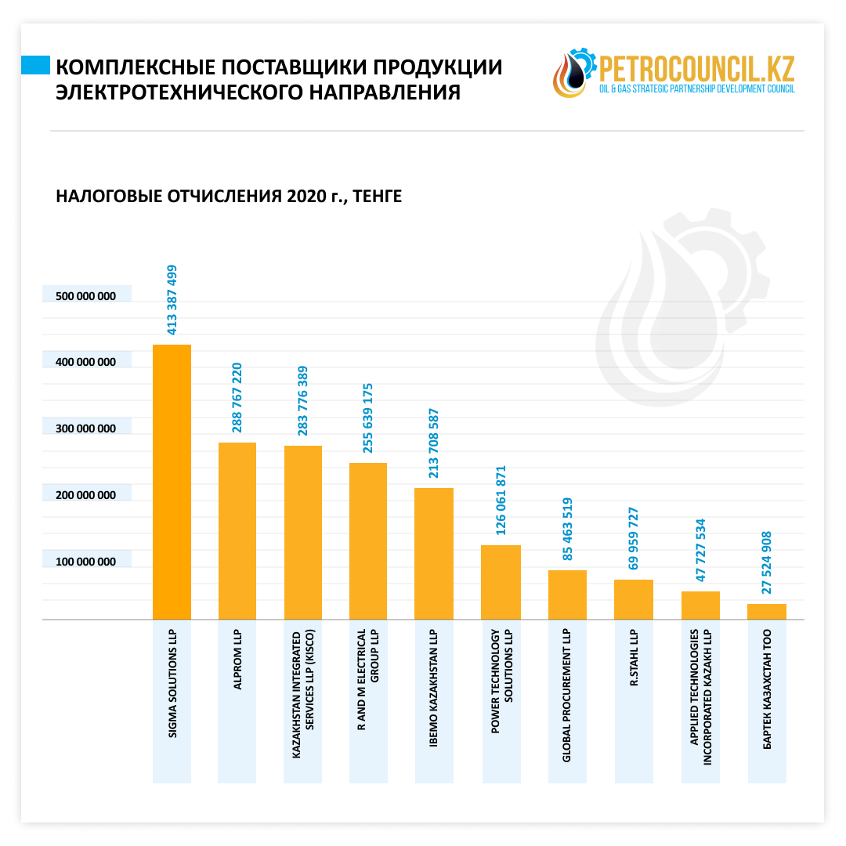
ANALYSIS AMONG COMPLEX SUPPLIERS BY PETROCOUNCIL.KZ
#webringthepower
Sigma has been named a Leader among complex suppliers of electrical bulk materials by Petroconcil.kz

Slide 5
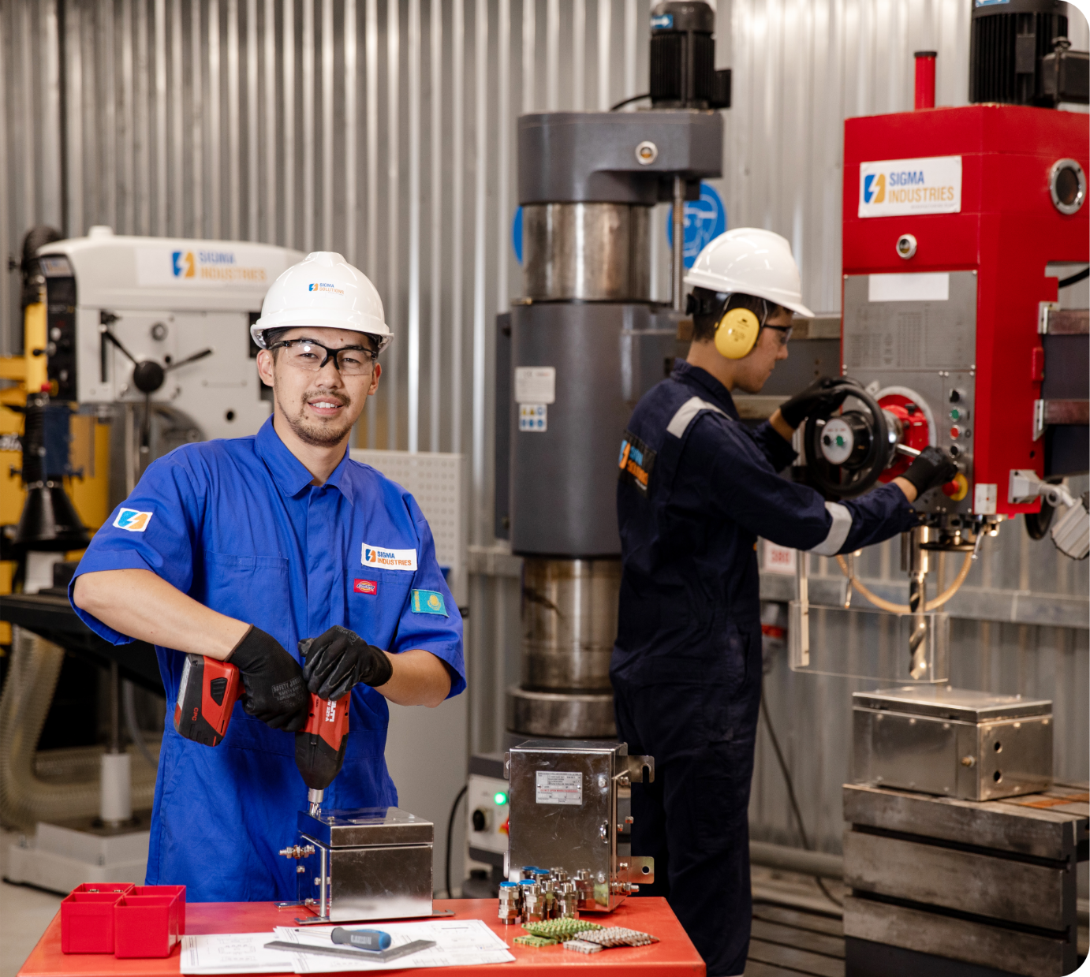
NEW DIRECTION
In 2018, it was made a strategic decision to establish local production of explosion-proof equipment, as there are currently no companies in the Republic that produce explosion-proof individual products or provide complex solutions in this field.

Slide 6
COMPANY’S AIMS
Offering competitively priced prices
Future-oriented export development
Involvement of local specialists
High-quality technical service
Saturation with products with high local content
Short supply terms for standard solutions

Slide 7
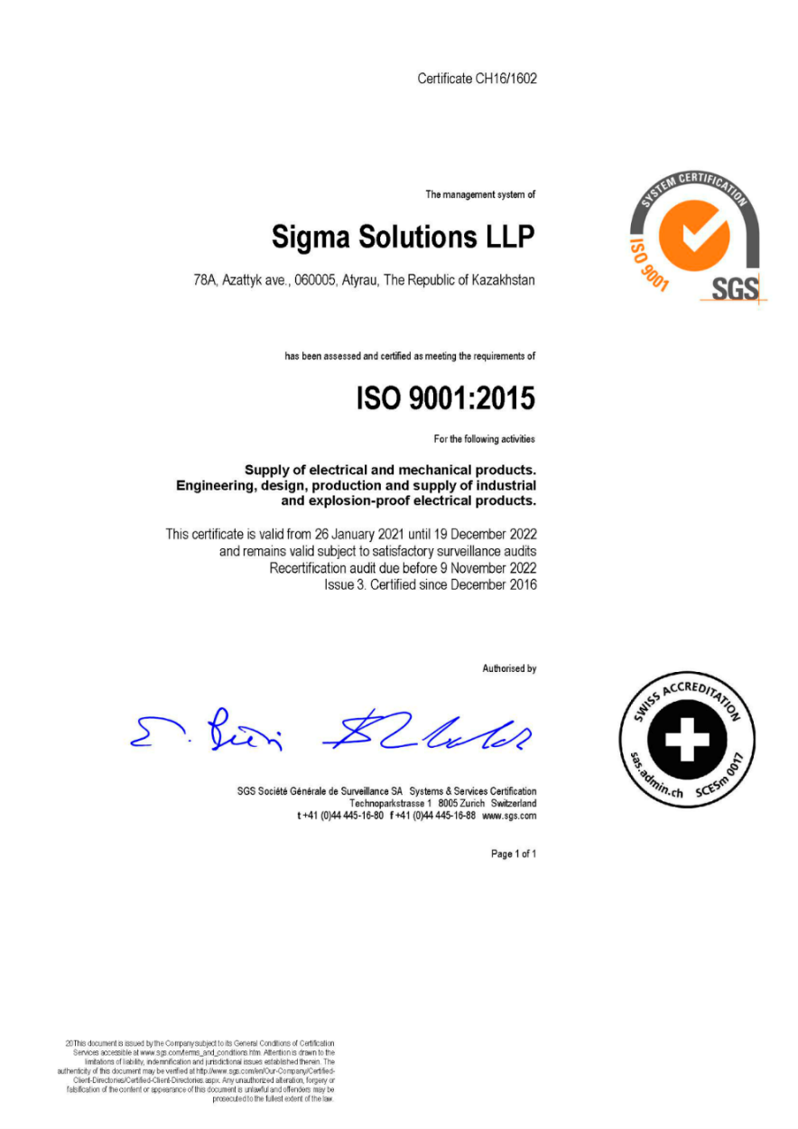
QUALITY MANAGEMENT SYSTEM
- ISO 9001 Quality Management System
- ISO 45001 Health & Safety Management System
- ISO 14001 Environmental Management System
- ISO IEC 80079:34 Quality Management Systems for Ex Product manufacture

Slide 8
COMPANY'S ENGINE IS ITS EMPLOYEES!
The main proof of the status of a leading company is comprehensive development. As employees develop, so does the company, and the quality of our products and service improves.

Slide 9
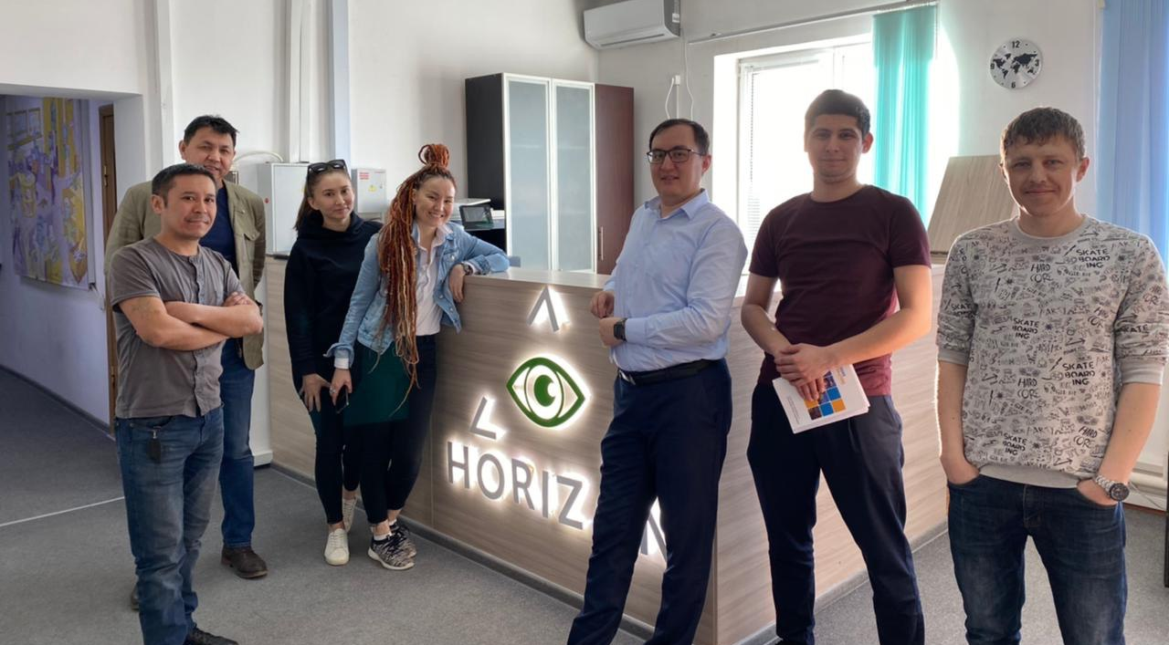
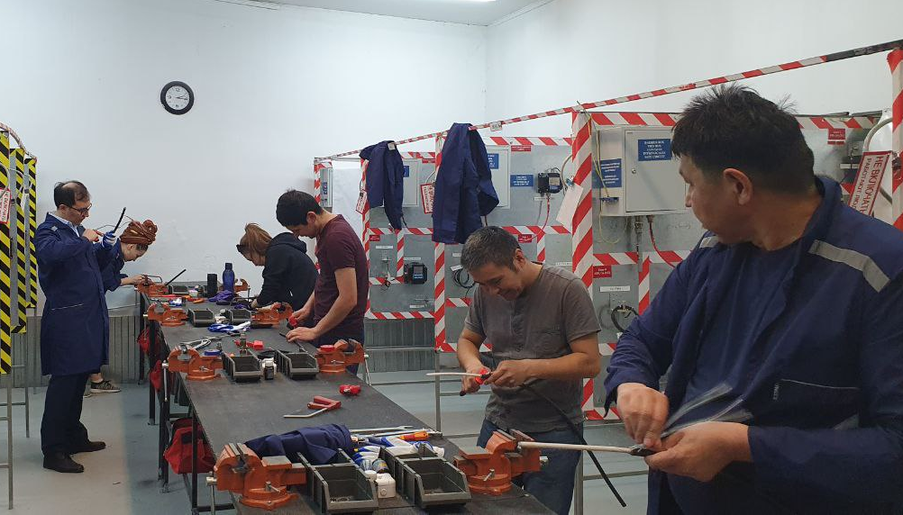
Over the past few years, a number of training courses were organized in cooperation with the manufacturer of Explosion Proof Cable Glands CMP at TCO, KPJV, Senimdi Kurylys and other companies
Our specialists have completed all compulsory Electrical and Compex Foundation Explosion-Proof courses at training centre of Horizon INC LLP

Slide 10
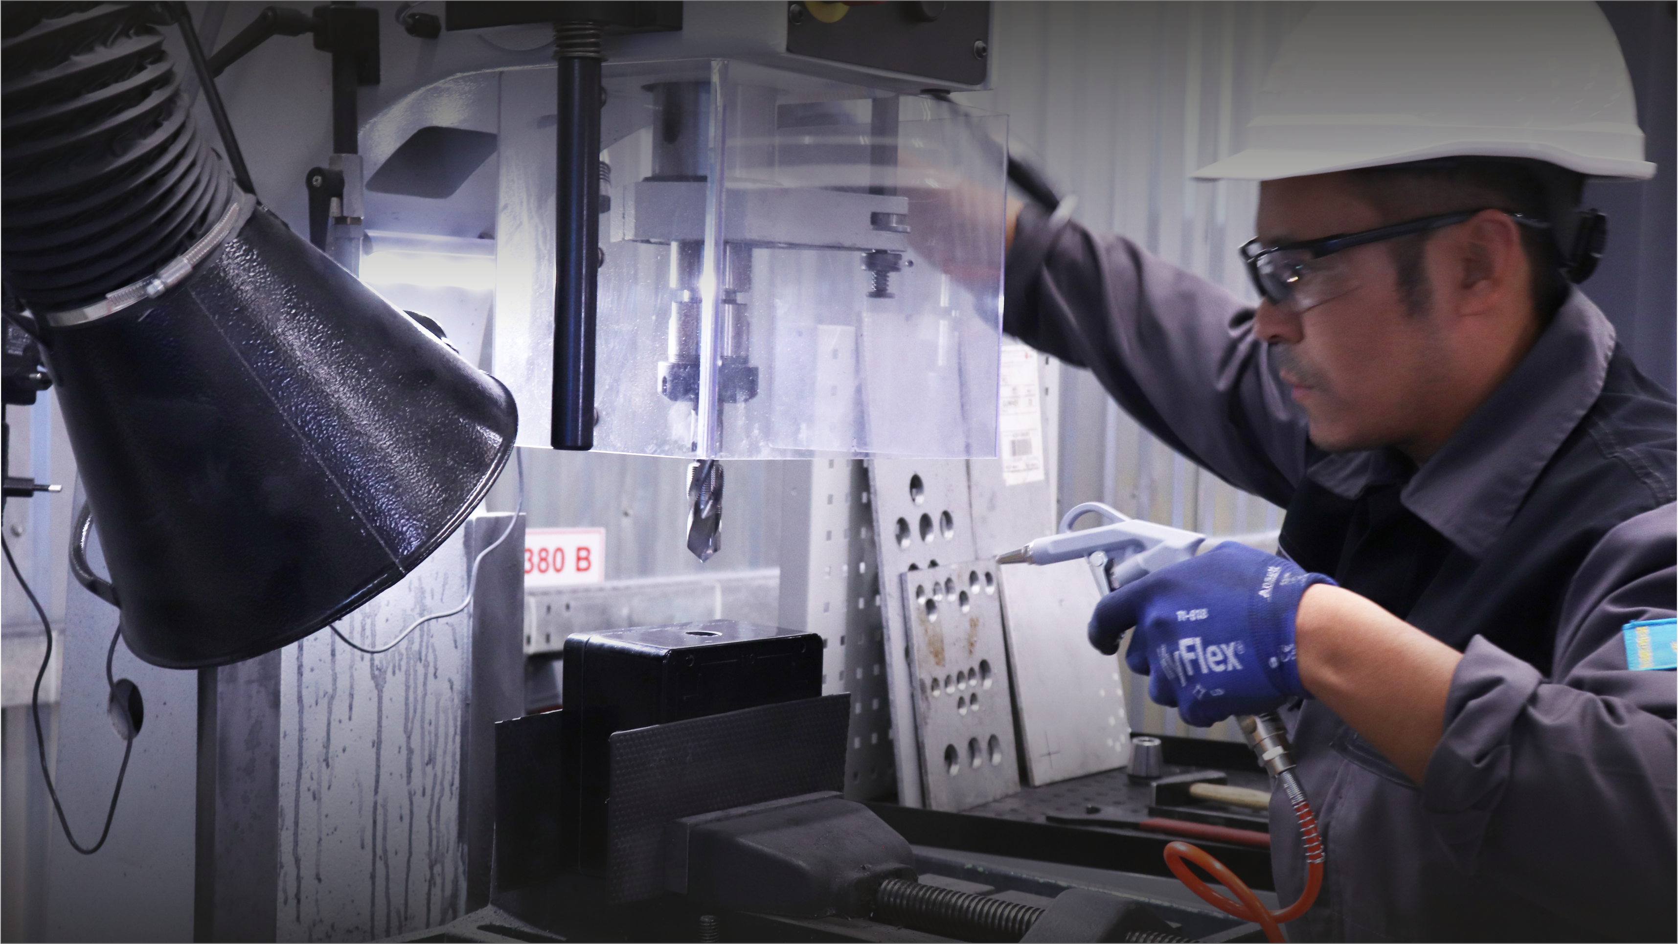
QUALITY TOOLS AND EQUIPMENT
MULTIFUNCTIONALITY
RELIABILITY
USABILITY
ECO-FRIENDLY
ENERGY EFFICIENT

Slide 11
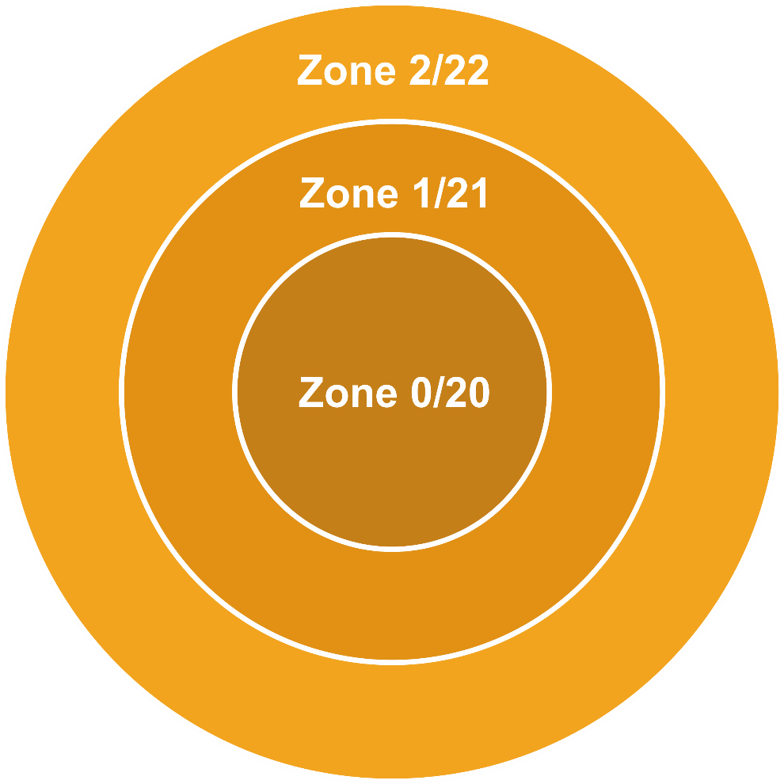
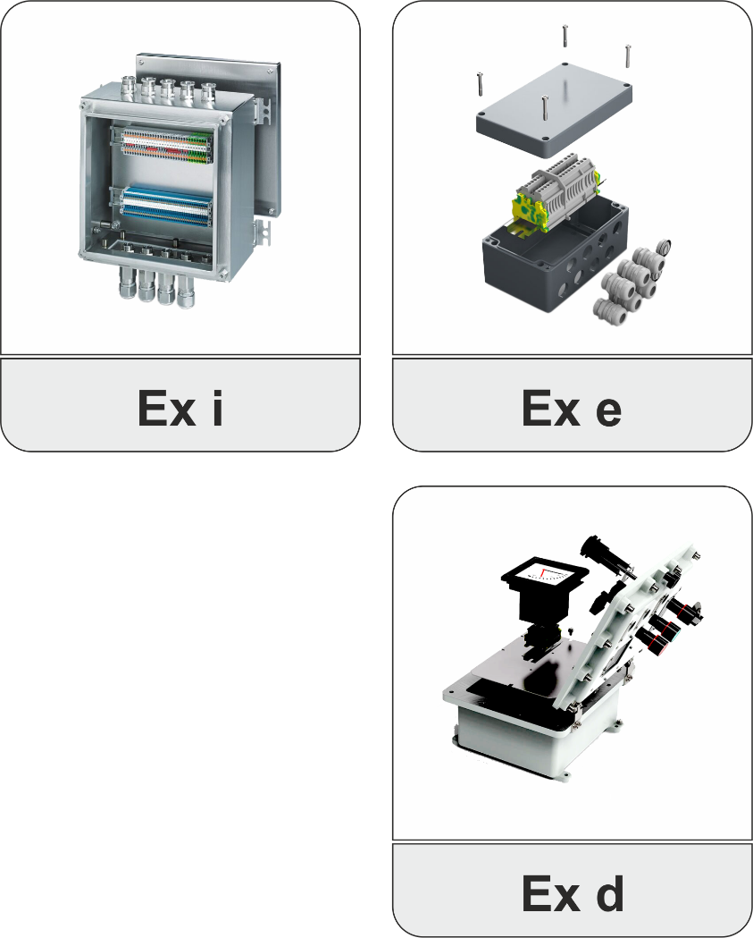
EXPLOSION-PROOF EQUIPMENT

Slide 12
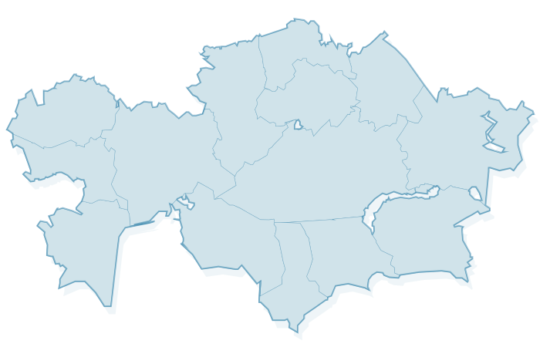
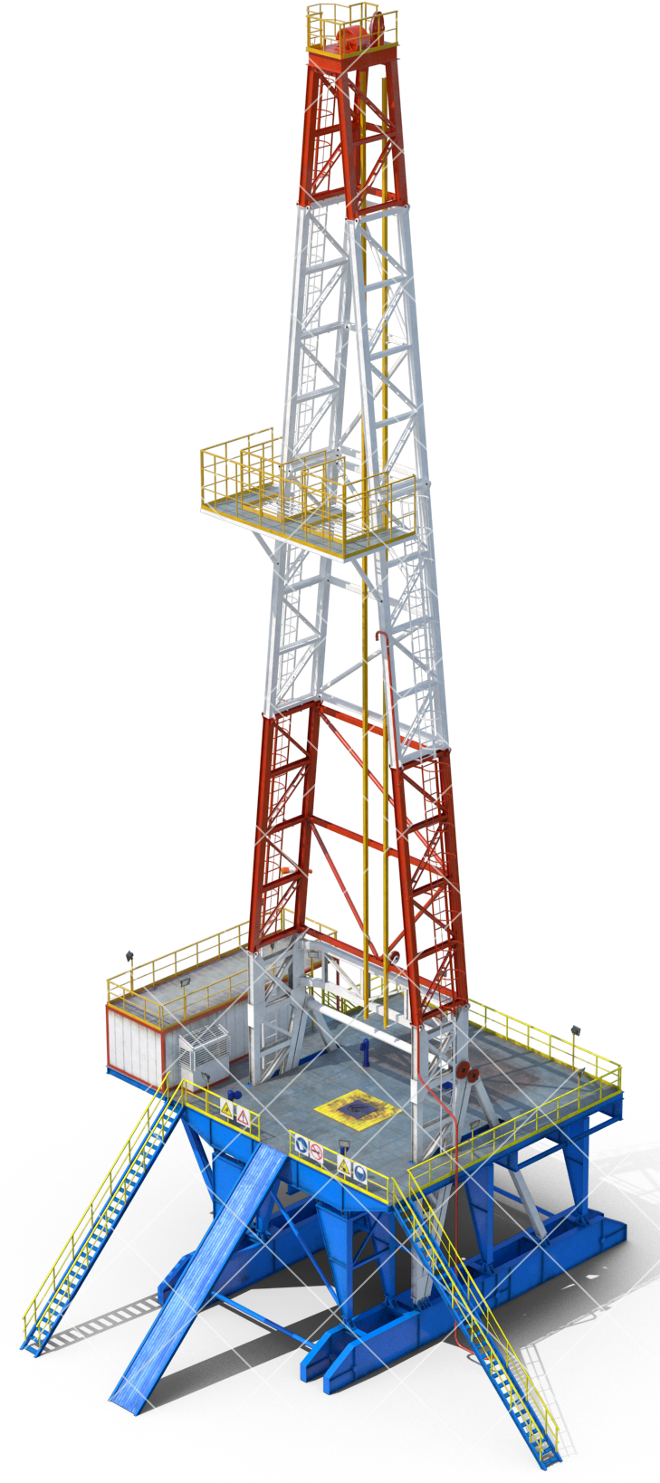
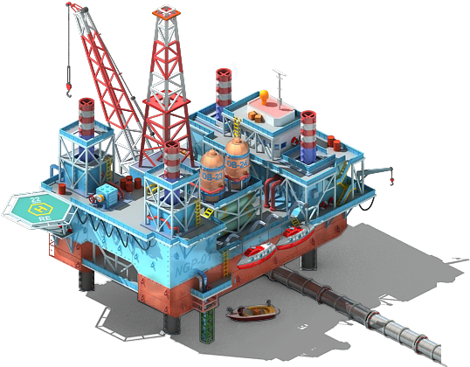
GEOGRAPHY
The production base and component warehouses are close to the main Oil & Gas operators in Western Kazakhstan.
This advantage will accelerate the process of import substitution while maintaining the highest level of product quality and engineering solutions.
#webringthepower

Slide 13
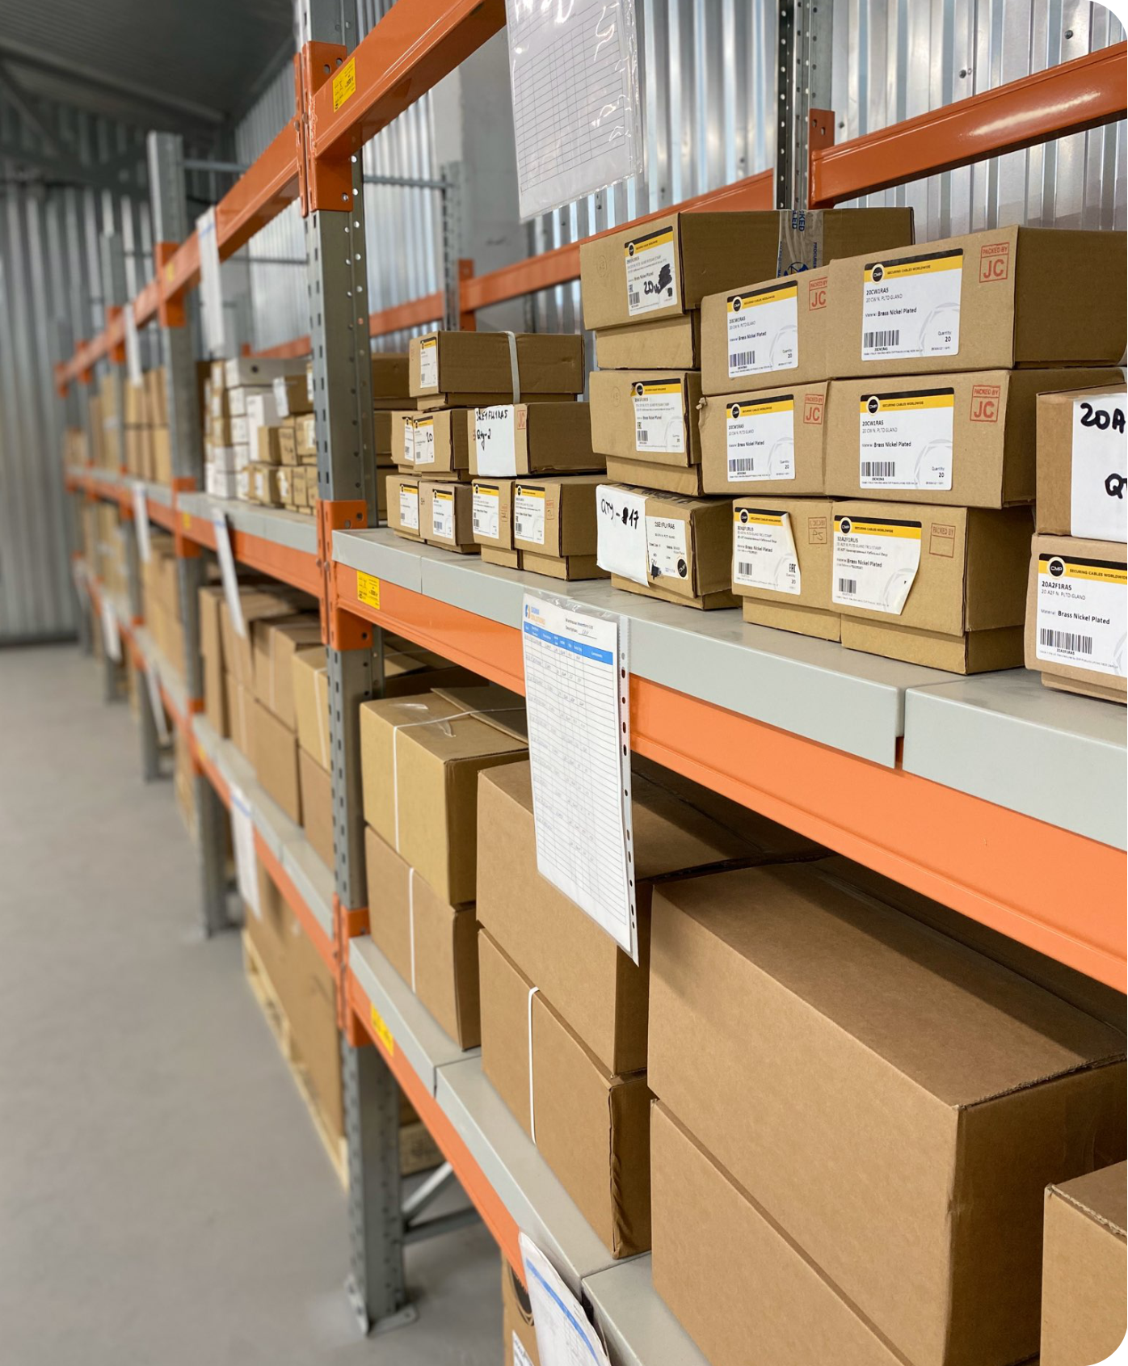
WORKSHOP & STORAGE AREAS
Workshop Location:
116A Azattyk ave, Atyrau, CDC base
060005, Republik of Kazakhstan
Areas:
Workshop – 192 sq.m.
Warehouse – 434 sq.m.
Office – 350 sq.m.
Employees:
Production – 6 employees
Administration – 29 employees
Warehouse are appointed with certified pallet racks.
All premises passed workplace accreditation

Slide 14
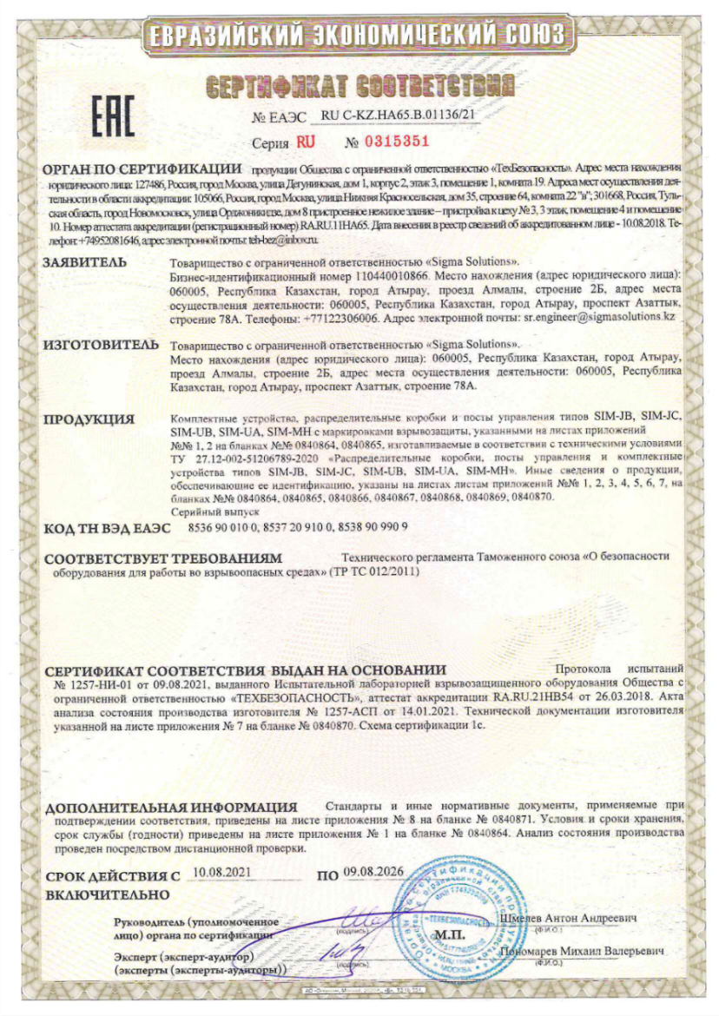
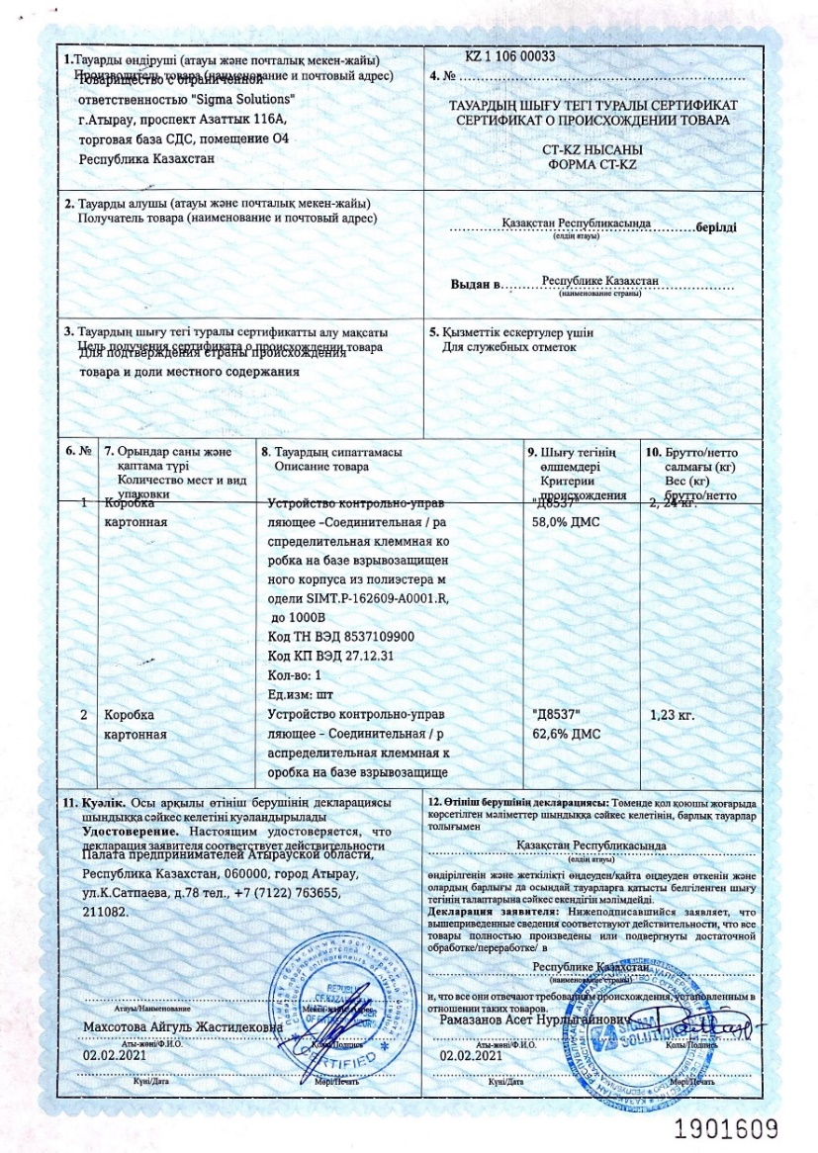
TR CU & CT-KZ CERTIFICATES
All products are certified in accordance with the Technical regulations of the Customs Union TR CU 012/2011 "On the safety of equipment in explosion hazardous environments" and are subject to a local content fraction assessment according to CT-KZ form.

Slide 15
#webringthepower
TOTAL DUNGA, PHASE III
Type: SIM-JB.A (Ex d)
Share of local content is 51.97%

Slide 16
#webringthepower
WORK EXPERIENCE

Slide 17
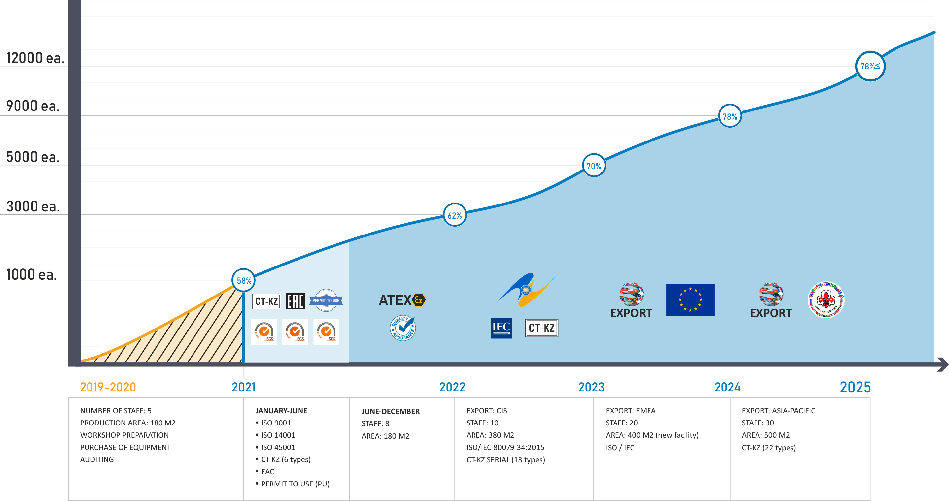
PRODUCTION OF JUNCTION BOXES (JBs)
* Local Content Level in the percentage (%)
* Equipment applicable in all hazardous areas - 0,1, 21, 22

Slide 18
CONTACTS
KAZAKHSTAN
78A, Azattyk ave., Atyrau,
060005, Republic of Kazakhstan
www.sigmasolutions.kz
sales@sigmasolutions.kz
SIGMA GROUP
UNITED KINGDOM
Unit 1, Sitwell Business Centre,
Heage Rd, Ripley, Derbyshire, UK.
www.sigmaexport.co.uk
sales@sigmaexport.co.uk
RUSSIA
Office 8, Boyevaya Street, 57A, 414024,
Astrakhan, Russian Federation.
www.sigmasolutions.ru
sales@sigmasolutions.ru
www.sigma-group.com

